Slide 1

Prototype Presentation
Presented By: Brandon Knutson, Daniel Cooke, Isaiah Padilla, Mason Goodman, Mica Nellis, Russel Stringham

Slide 2
Project Description
Clients: Andrew Acosta & Arjun Banerji
Description:
Design a robotic drilling arm for Northrop Grumman Space Systems for vehicles that aid in sending satellites to orbit
Drill through composite materials to be able to bolt secondary structures such as brackets or tubing
Most importantly drilling through cylindrical structures that are used to connect entire vehicle together
Four Axis robotic drilling arm
  Axis 1: Base axis of the robot allowing for movement left to right
  Axis 2: Allows robotic arm to move forward and backwards from its center controlling the lower half
  Axis 3: Provides robots the ability to move in the x, y, and z controlling upper arm allowing for vertical reach
  Axis 4: End-effector location allowing “wrist” to rotate
Importance:
More efficient for Northrop Grumman
Able to manufacture “in house”
Saves time and money in regards to various tests to be performed
[1]

Slide 3
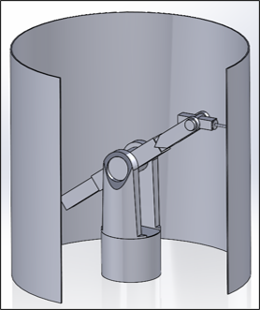
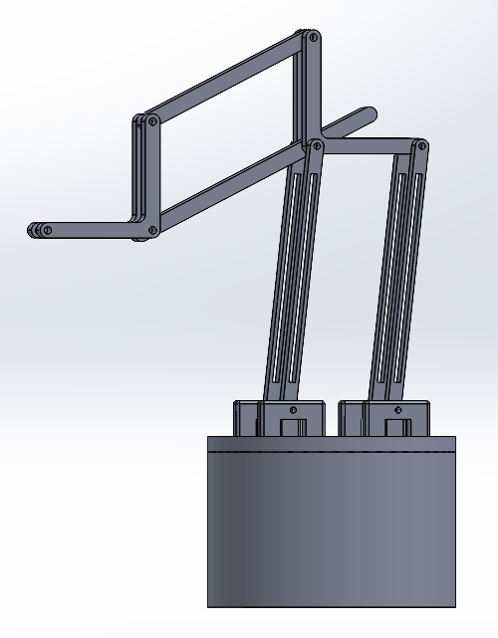
Design Description: Functionality
3 Motors
Linear Actuators
Rotating Base
Bad Tolerancing
3 Motors
No Linear Actuators
Parallel Beams
Rotating Base
Drill perpendicular to cylinder
Notes:
Provide a high-quality top-level and labeled drawing views of your design identifying major sub-systems. Use Solidworks/Onshape balloons and leader-line notes for this identification.
• Also provide a bullet list describing how your top-level design functions.
• Also provide a bullet list describing how each sub-systems function.

Slide 4
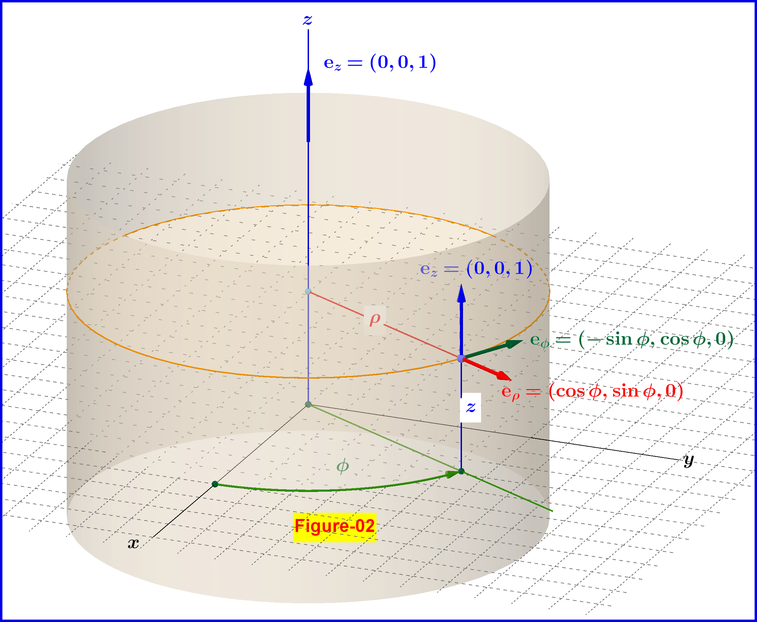
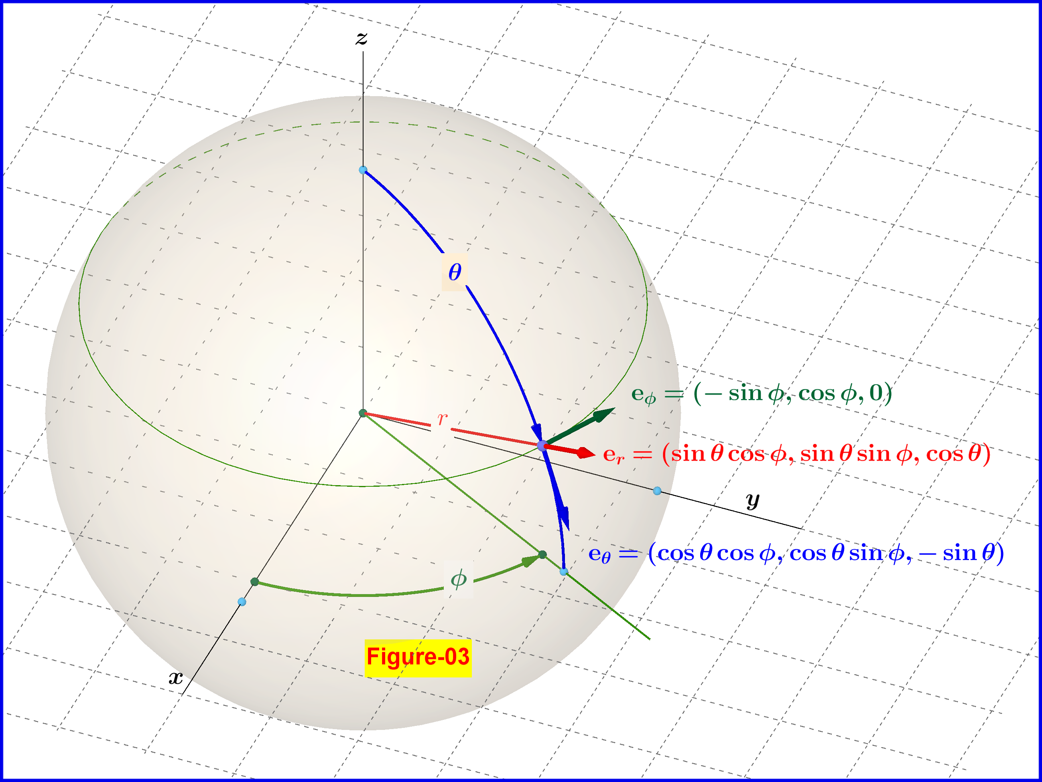
Movement Design: (Brandon)

Slide 5
Virtual Prototype
Questions Being Answered:
Can this prototype move in such a way that allows for optimal drilling?
Are various angles, heights, and lengths within reach?
Answers:
The teams prototype does allow for optimal drilling although the addition of an end-effector is a primary next step
The angles, heights, and lengths we hoped for are being met although the additions of pins at the mates within the model will allow all components to stay fully in place and prove this mush more effectively
Next Steps:
Addition of end-effector, bearings, motors, and pins as needed
Create CAD with proper scaling that will be our final design
Potentially change the base of the robotic drilling arm to a "tripod" like design

Slide 6

Virtual Prototype

Slide 7
Physical Model
Goals
Determine functionality of 2D kinematics.
Determine required bearing surfaces.
Required holding torque/ motor torque-speed characteristics for second prototype.
Gear box output requirements.
What are the interferences and the allowed range of motion?
Answers
2D kinematic function as desired, little interference, reaches desired range of motion.
All contact surface will require bearings.
Counter-weight aids in actuation of the end effector.
Gear box with at least 5:1 gear ratio will be required it increase torque output.
Next Steps
Design gear boxes
Figure out Arduino

Slide 8
Questions?

Slide 9
Resources
[1]“What is a Four-Axis Robot?” https://robotsdoneright.com/Articles/what-is-a-four-axis-robot.html#:~:text=parts%20more%20accessible.-,%E2%80%A2,is%20able%20to%20rotate%20parts.
[2] Slewing Rings, Catalog 404. Schaeffler Technologies AG & Co. KG, 2012.
[3] “DatasheetDirectory,”Globalspec.com,2020.https://www.globalspec.com/specsearch/partspecs?partId=
[4]“Moment of Inertia - Formulas, MOI of Objects [Solved Examples],” BYJUS. https://byjus.com/jee/moment-of-inertia/
‌[5] “Relation Between Torque And Moment Of Inertia - BYJU’S,” BYJUS. https://byjus.com/physics/relation-between-torque-and-moment-of-inertia/
‌[6] “Cubic spline interpolation with end conditions - MATLAB csape,” www.mathworks.com. https://www.mathworks.com/help/curvefit/csape.html (accessed Nov. 07, 2023).
‌[7] “Slug (unit),” Wikipedia, Feb. 17, 2021. https://en.wikipedia.org/wiki/Slug_(unit)
‌[8] Z. Xiao, H. Ma, Y. Lu, G. Zhang, Z. Liu, and Q. Song, “Real-Time milling tool breakage monitoring based on multiscale standard deviation diversity entropy,” International Journal of Mechanical Sciences, vol. 240, p. 107929, Feb. 2023, doi: https://doi.org/10.1016/j.ijmecsci.2022.107929.
‌[9] “40 Series (40mm Based Profiles) | Metric | T-Slotted Profiles | Framing Options,” 8020.net. https://8020.net/framing-options/t-slotted-profiles/metric/40series40mmbasedprofiles.html (accessed Nov. 07, 2023).
‌[10] “5 Causes of Motor Failure and How to Prevent Them,” www.acorn-ind.co.uk, May 16, 2018. https://www.acorn-ind.co.uk/insight/five-causes-of-motor-failure/
‌

